Slide 1
NOT-FOR-PROFITS & CHARITIES DATA SNAPSHOTS FROM IR AND DIA
April 2018
Presenter: Stewart .Donaldson@ird.govt.nz

Slide 2
INLAND REVENUE DATA
There are about 115,000 entities coded as NFPs on Inland Revenue’s records in 2018
115,000 NFPs
2

Slide 3
SNAPSHOT – TAX CHARITIES
About 28,000 NFPs are “tax charities” registered with DIA. There are also about 300 non-resident tax charities registered with IRD
115,000 NFPs
300 Tax Charities - IRD
28,000 Tax Charities - DIA
3

Slide 4
SNAPSHOT – OTHER EXEMPTIONS
About 25,000 NFPs qualify for specific income tax exemptions:
Bodies promoting amateur games and sports (23,000)
Local & regional promotional bodies (2,000)
Other bodies (240)
25,000 Tax exempt NFPs that are not Tax Charities
115,000 NFPs
300 Tax Charities - IRD
28,000 Tax Charities - DIA
4

Slide 5
SNAPSHOT – NFPs & INC <$1,000
About 20,000 NFPs have indicated to IRD they have net income below $1,000 and do not file income tax returns
25,000 Tax exempt NFPs that are not Tax Charities
115,000 NFPs
300 Tax Charities - IRD
10,000-20,000 NFPs with income below $1,000
28,000 Tax Charities - DIA
5

Slide 6
SNAPSHOT – DONEE ORGS
About 25,000 NFPs are donee organisations
22,500 are tax charities; 2,000 are schools, 500 have benevolent, philanthropic or cultural purposes (or are unregistered charities)
25,000 Tax exempt NFPs that are not Tax Charities
115,000 NFPs
300 Tax Charities - IRD
25,000 donee organisations
10,000-20,000 NFPs with income below $1,000
28,000 Tax Charities - DIA
6

Slide 7
SNAPSHOT – GST
About 18,000 NFPs are GST registered
13,500 charities received $268m GST refunds in the 12-months ending March 2015
25,000 Tax exempt NFPs that are not Tax Charities
115,000 NFPs
300 Tax Charities - IRD
25,000 donee organisations
10,000-20,000 NFPs with income below $1,000
18,000 NFPs registered for GST
28,000 Tax Charities - DIA
7

Slide 8
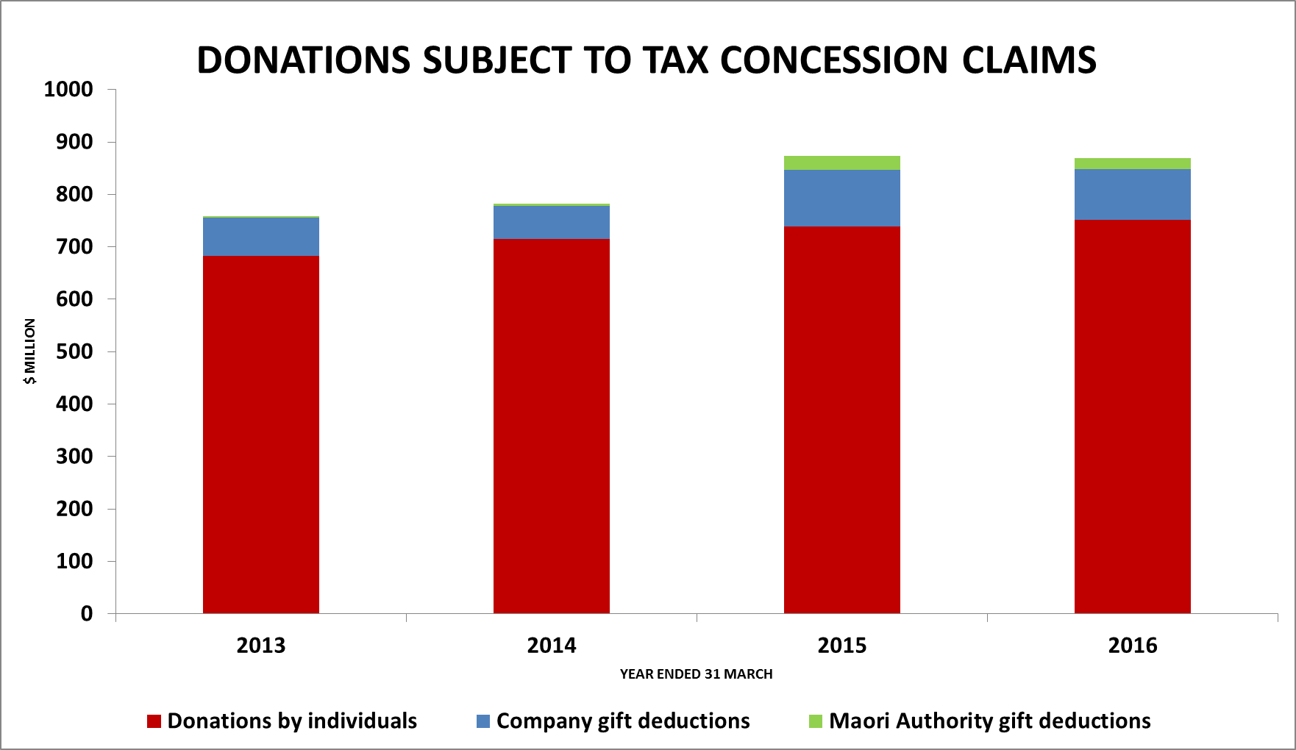
8

Slide 9
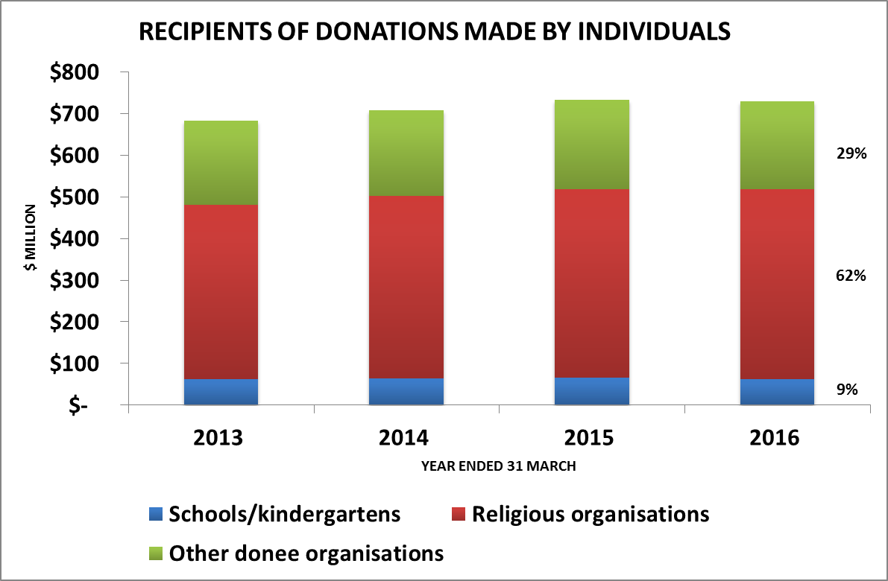
9

Slide 10
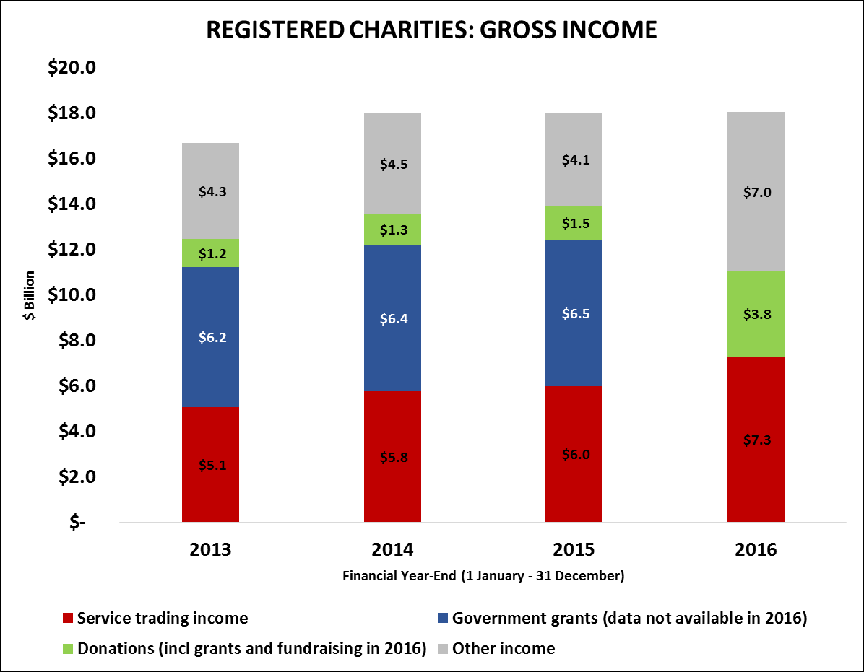
10

Slide 11
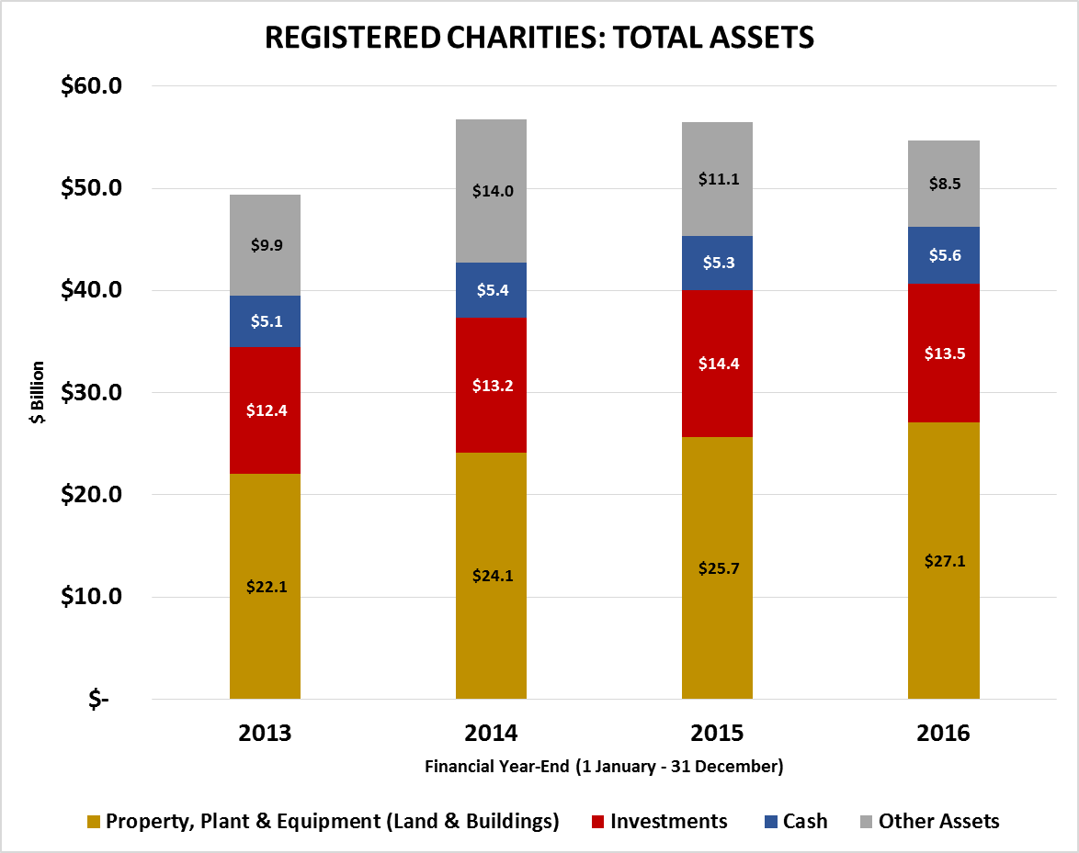
11

Slide 12
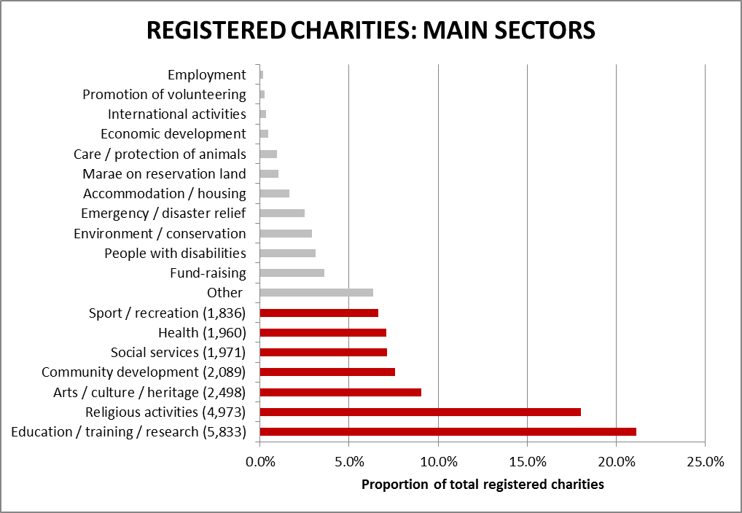
12

Slide 13
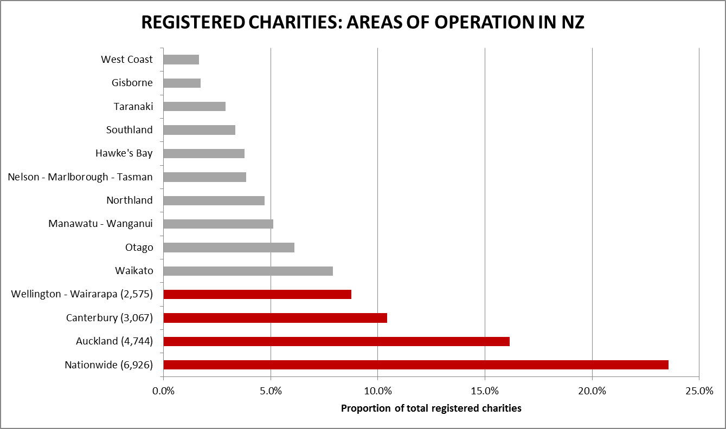
13

Slide 14
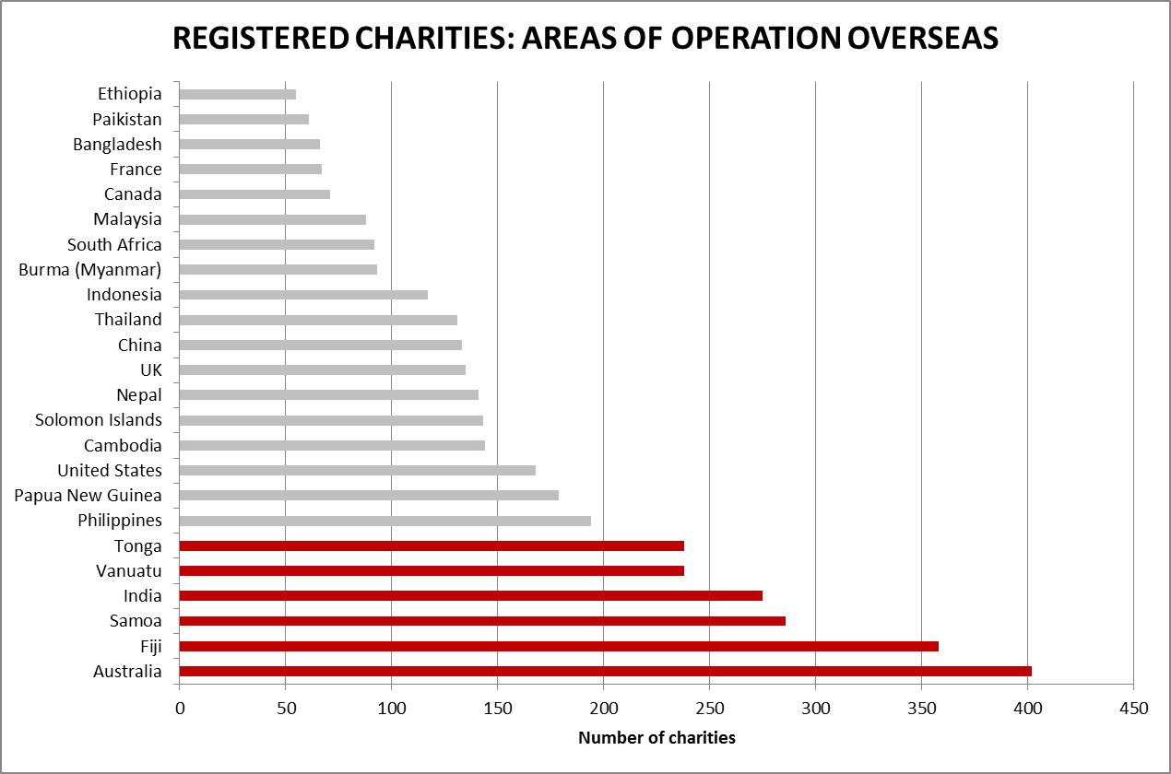
14

